Slide 1
Lecture 15
Topics:
Logic of Integer Representation
Decimal and Hexadecimal Representations
Binary Representation
Binary Addition Algorithm
Binary Multiplication Algorithm

Slide 2
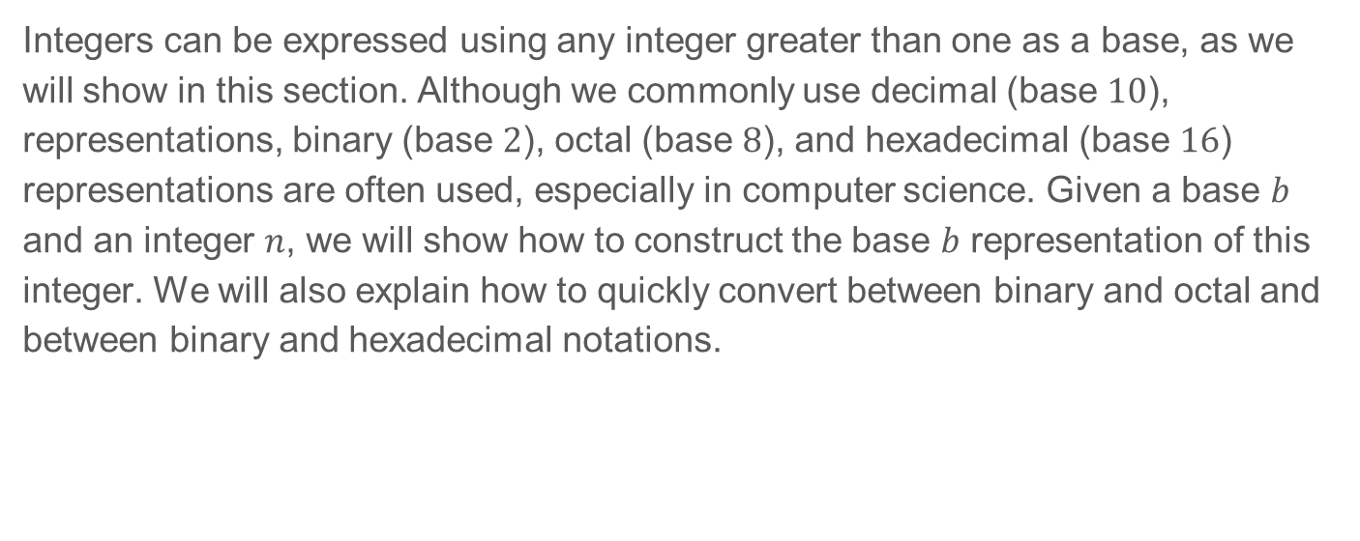
4.2 Integer Representations and Algorithms

Slide 3
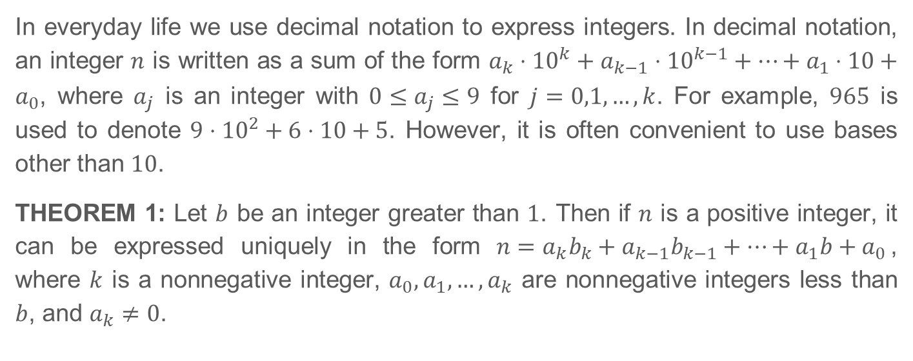
4.2.2 Representations of Integers

Slide 4
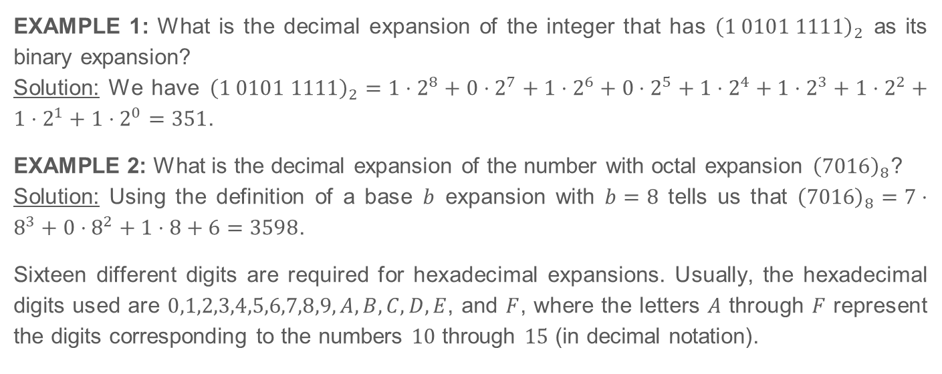
4.2.2 Representations of Integers (Continued)

Slide 5
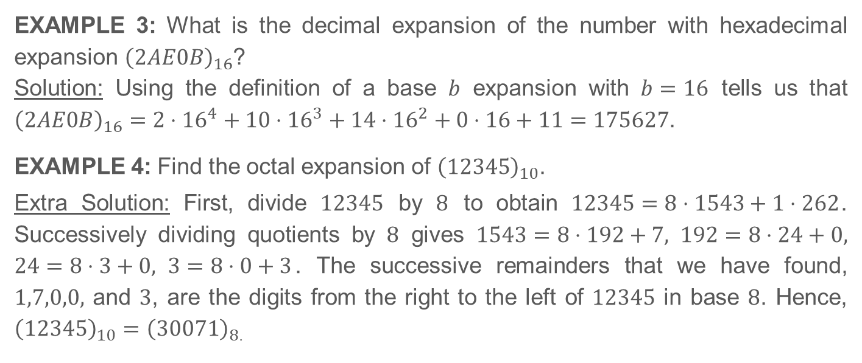
4.2.2 Representations of Integers (Continued)

Slide 6
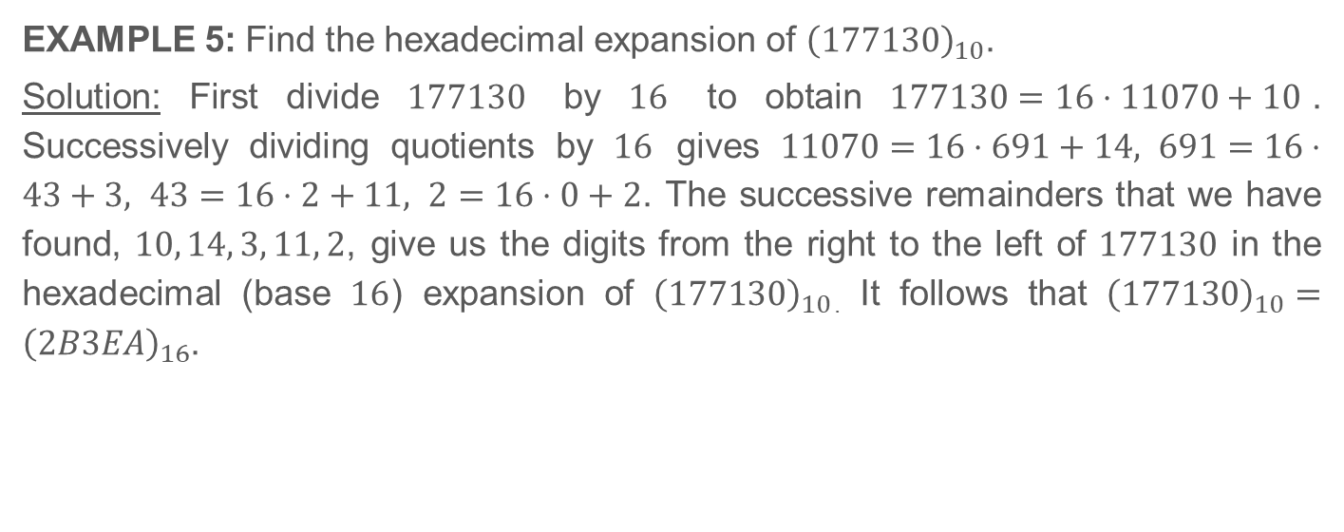
4.2.2 Representations of Integers (Continued)

Slide 7
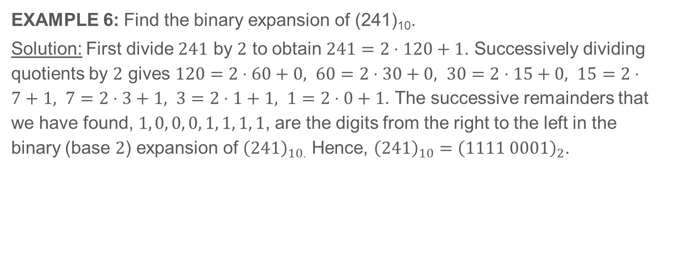
4.2.2 Representations of Integers (Continued)

Slide 8
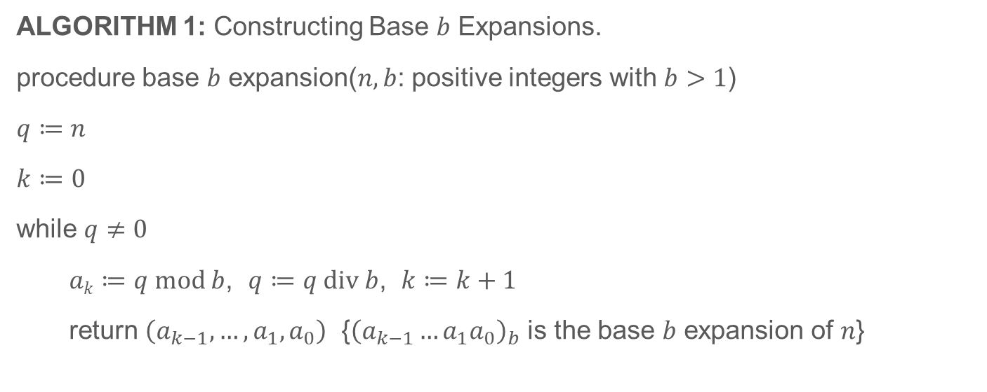
4.2.2 Representations of Integers (Continued)

Slide 9
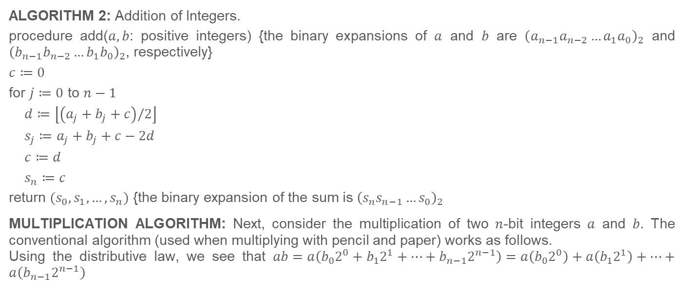
4.2.2 Representations of Integers (Continued)

Slide 10
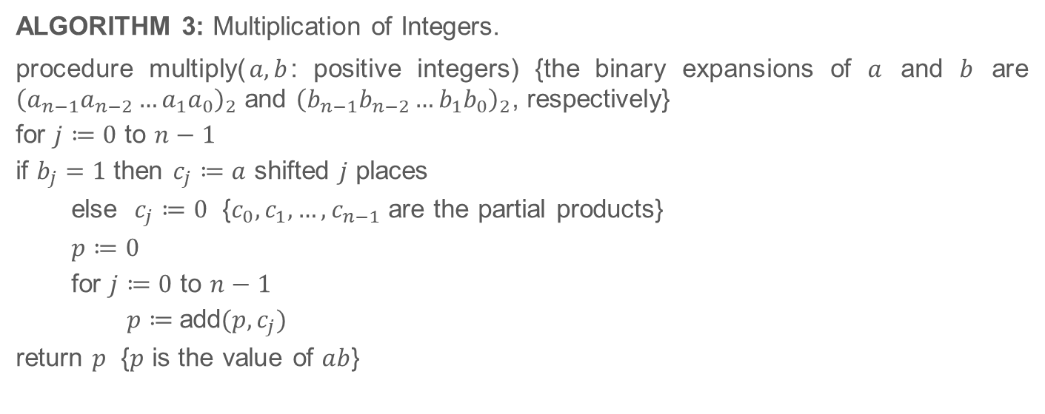
4.2.2 Representations of Integers (Continued)

Slide 11
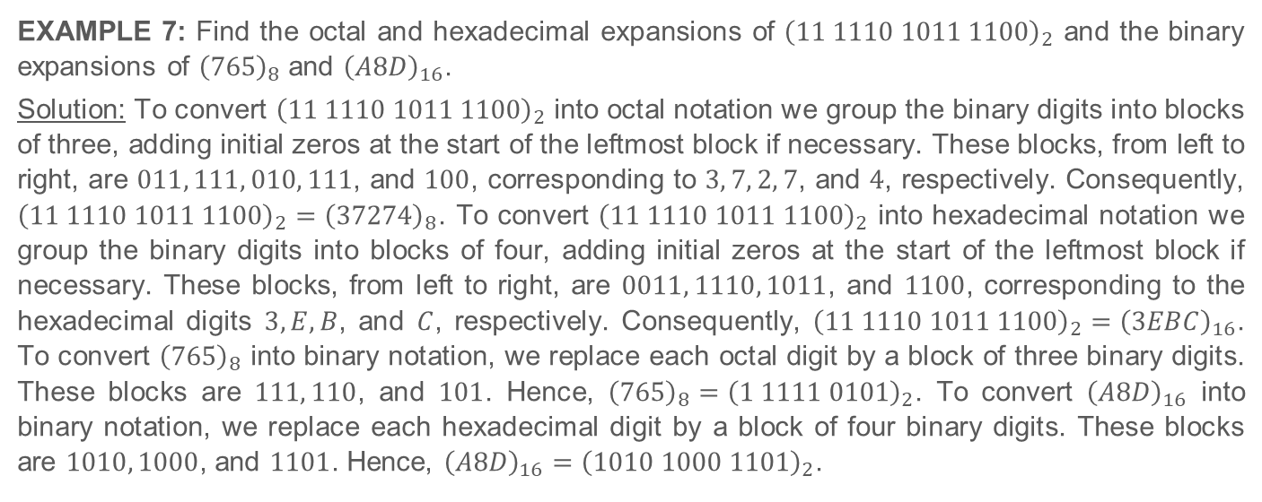
4.2.2 Representations of Integers (Continued)

Slide 12
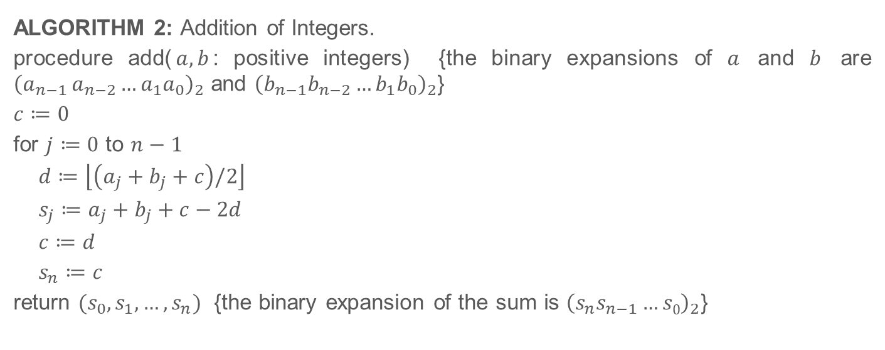
Integer Operations

Slide 13
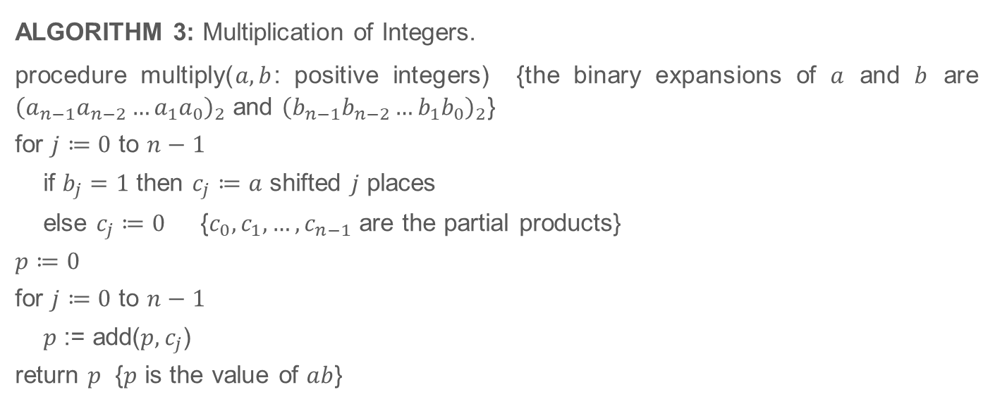
Integer Operations (Continued)

Slide 14
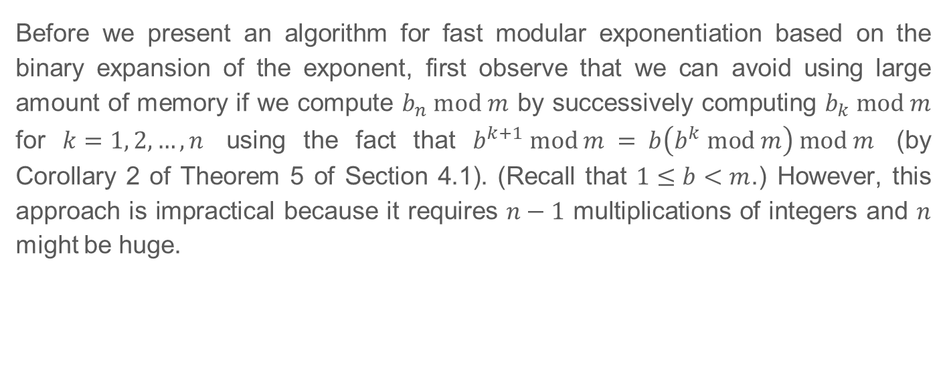
4.2.4 Modular Exponentiation
Self Study and Homework

Slide 15
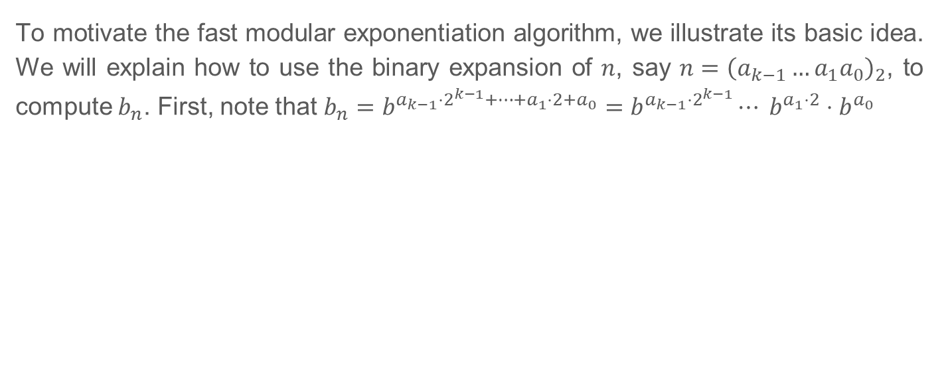
4.2.4 Modular Exponentiation (Continued)
Self Study and Homework

Slide 16
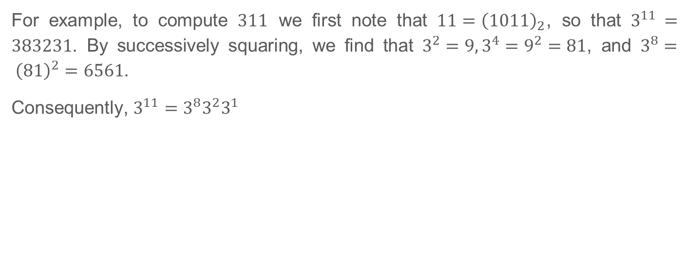
4.2.4 Modular Exponentiation (Continued)
Self Study and Homework

Slide 17
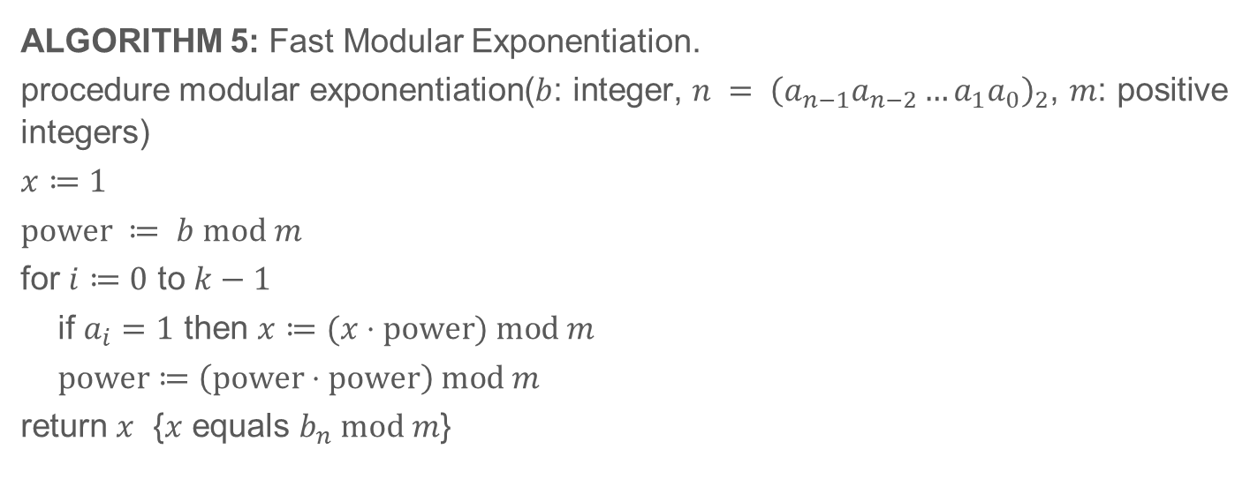
4.2.4 Modular Exponentiation (Continued)
Self Study and Homework

Slide 18
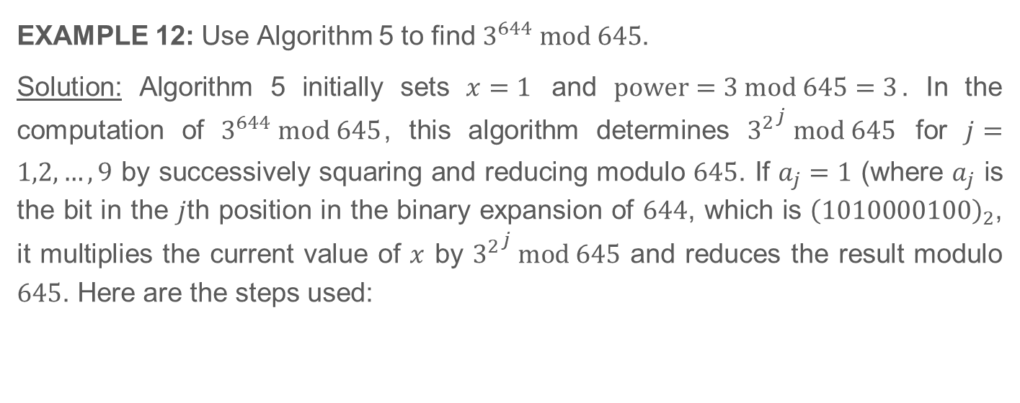
4.2.4 Modular Exponentiation (Continued)
Self Study and Homework

Slide 19
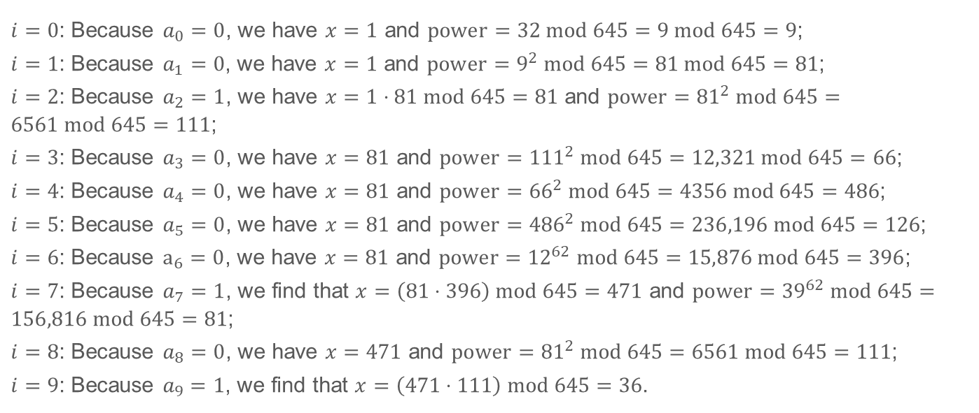
4.2.4 Modular Exponentiation (Continued)
Self Study and Homework

